Slide 1


The Writing Process
Thoughts
Papers

Slide 2

None of us are born knowing how to write.

Slide 3
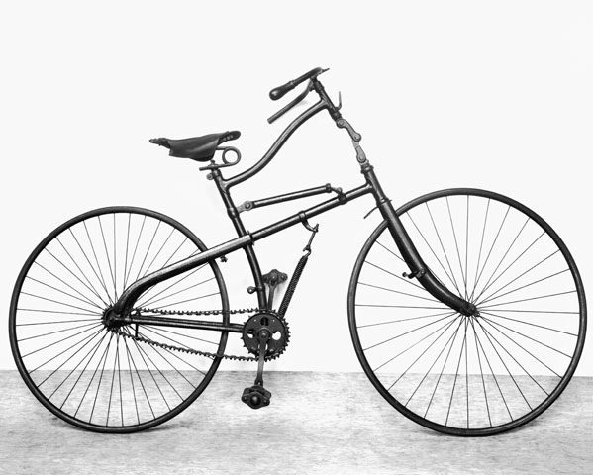
Like riding a bicycle, writing is learned.

Slide 4

The writing process consists of FIVE easy steps.

Slide 5
These are: 1. Prewrite 2. Outline 3. Draft 4. Revise Your Thinking 5. Correct the Sentences

Slide 6
The biggest mistake that students make is to start writing without planning their work. The difference between students who write A-papers and students who write C-papers is NOT their fluency in English or their overall intelligence. Students who use the writing process make better grades, period.

Slide 7

Prewriting. First, choose a topic. 1. The idea must be broad enough to allow you to write a paper of sufficient length. 2. The topic must be narrow enough to allow you to cover that topic within reasonable length.

Slide 8

Next, think about your topic. If you are writing about a topic you know very well, like your grandmother, then make notes about what you will say. If you are writing about something that you do not know very well, then research the topic. Read. You are in college now. You want to give correct information! Organize your project before you write.

Slide 9
A few practical suggestions: 1. Do NOT let fear paralyze you! Get busy! 2. You can begin with almost anything. 3. Choose something you would enjoy writing about or learning more about. 4. Narrow “broad” topics by making them more specific. Replace vague words with specific words. 5. Use the magic word “because” to give reasons for your selection. Even though you are writing an expressive essay, you still need to give your reasons. 6. Turn your notes into a complete sentence. You should now have a serviceable topic.

Slide 10
For example, say you have to write a paper about your favorite animal. 1. Narrow to “cats.” 2. Narrow to “tigers.” 3. I like tigers. 4. I like Bengal tigers. 5. Bengal tigers are my favorite animal. 6. Bengal tigers are my favorite animal because…

Slide 11

1. Jot down your ideas. Think about them. 2. Figure out what points you want to make to support your topic. 3. Keep in mind your length requirement!

Slide 12
When you know what you want to say, you write your introduction or thesis statement. You have then finished the 1st step.

Slide 13

The 2nd step is to make an outline.

Slide 14
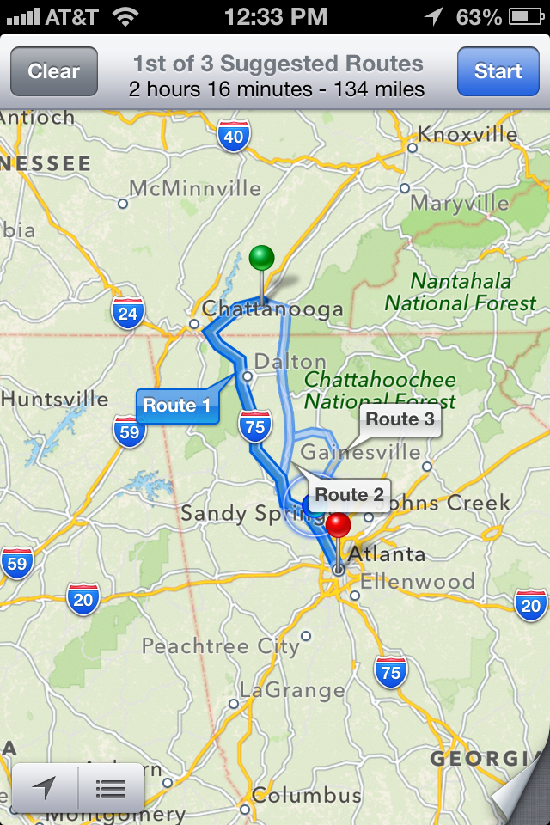
An outline is like a map. It is a plan or blueprint to write your paper.

Slide 15
Introduction to the Writing Process I. None of us are born knowing how to write. II. Writing is a learned skill. III. Five Steps of the Writing Process A. Choose a topic. 1. Right size. 2. Suggestions for narrowing a topic. 3. Example for choosing a topic. 4. Jot down ideas. 5. Figure out points you want to make to support your theme. 6. Remember your length requirement. B. Outline. 1. An outline is a map or plan. 2. Sample outline. 3. An outline breaks down the paper into small, manageable tasks. C. Draft your paper. 1. A draft is “work-in-progress.” D. Revise your thinking. a. Add information? b. Cut information? c. Good examples? Enough examples? c. Get feedback from the SALL Center or a peer. D. Proofread your sentences. 1. Is the document formatted according to instructions? 2. Read your essay out loud! 3. Grammar, punctuation, word choice, spelling, sentence length. IV. Use the five-step writing process to make your college writing better!

Slide 16

An outline reduces one big paper into a series of small, easily accomplished tasks.

Slide 17

It’s like taking a bite instead of swallowing the whole apple…

Slide 18

The 3rd step is to draft your paper.

Slide 19

We use the word “draft” because it indicates a work-in-progress.

Slide 20


The 4th step is to revise your paper focusing entirely on your thinking.

Slide 21
1. If you are missing details or information, what do you need to add to be convincing? 2. If you have information that is off-topic or “wordy,” what do you need to cut? 3. If find any grammatical errors, fix them. (Reading out loud will help).

Slide 22
This is the correct place to ask someone to read your paper. You might ask your professor, a friend, or someone in the SALL Center. 1. Is your thinking clear? 2. Do your examples support your main ideas? 3. Are your sentences short and easy to read? 4. Is your grammar, punctuation, and spelling correct? 5. If you read a paper for one of YOUR friends, remember to find something to praise in their essay.

Slide 23

The 5th and final step is to proofread your paper very carefully! You want to read every sentence very carefully to make sure that your grammar and word choice is correct.

Slide 24

Is the document formatted according to instructions?

Slide 25
Read your paper out loud.
Reading OUT LOUD makes it easier to find errors such as spelling miskates…

Slide 26
Word Choice:
Do you use common, simple, easily understood words?
Have you used wrong words such as there when you mean their, or effect when you mean affect…
Are you missing words?
Have you controlled your sentence structure and sentence length?
Is your punctuation correct?

Slide 27
Keep your writing simple. Ask yourself, “Would I say this to my best friend’s mother?”
If not, then re-write the sentence!
DO NOT TRY TO SOUND LIKE A HISTORY PROFESSOR.
You have plenty of time to learn to write more complex sentences. First, learn to write clear, precise, simple, easily understood sentences.

Slide 28

So that’s it. Five easy steps in the writing process.
Topic
Outline
Draft
Revise
Proofread

Slide 29

Use the writing process and you will make your college writing easier and better!

